Slide 1
Introduction to HTML Part 2
Svetlin Nakov
National Academy for Software Development
academy.devbg.org
Notes:
*
07/16/96
(c) 2007 National Academy for Software Development - http://academy.devbg.org. All rights reserved. Unauthorized copying or re-distribution is strictly prohibited.*
<number>##

Slide 2
Contents
HTML Tables
  Nested Tables
  Cells Width
  Cell Spacing and Padding
  Column and Row Span

Slide 3
Contents (2)
HTML Forms
  Form Fields
  Form Controls
    Text field
    Text area
    Select
    Radio button
    Checkbox
    Button
    Image button

Slide 4
Creating HTML Tables
Notes:
*
07/16/96
(c) 2007 National Academy for Software Development - http://academy.devbg.org. All rights reserved. Unauthorized copying or re-distribution is strictly prohibited.*
<number>##

Slide 5
HTML Tables
Tables represent tabular data
  A table consists of one or several rows
  Each row has one or more columns
Tables comprised of several core tags: <table></table>: begin / end the table
<tr></tr>: create a table row
<td></td>: create tabular data (cell)
Tables are losing favor to <div> and <span>, with the CSS revolution
Notes:
*
07/16/96
(c) 2007 National Academy for Software Development - http://academy.devbg.org. All rights reserved. Unauthorized copying or re-distribution is strictly prohibited.*
<number>##

Slide 6
HTML Tables (2)
Start and end of a table
Start and end of a row
Start and end of a cell in a row
<table> ... </table>
<tr> ... </tr>
<td> ... </td>

Slide 7
Simple HTML Tables – Example
<table border="1" cellspacing="0" cellpadding="5">
<tr>
<td><img src="ppt.gif"></td>
<td><a href="lecture1.ppt">Lecture 1</a></td>
</tr>
<tr>
<td><img src="ppt.gif"></td>
<td><a href="lecture2.ppt">Lecture 2</a></td>
</tr>
<tr>
<td><img src="zip.gif"></td>
<td><a href="lecture2-demos.zip">
Lecture 2 - Demos</a></td>
</tr>
</table>

Slide 8
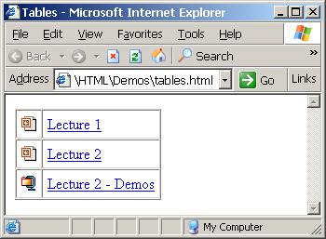
Simple HTML Tables – Example
<table border="1" cellspacing="0" cellpadding="5">
<tr>
<td><img src="ppt.gif"></td>
<td><a href="lecture1.ppt">Lecture 1</a></td>
<tr>
<tr>
<td><img src="ppt.gif"></td>
<td><a href="lecture2.ppt">Lecture 2</a></td>
<tr>
<tr>
<td><img src="zip.gif"></td>
<td><a href="lecture2-demos.zip">
Lecture 2 - Demos</a></td>
<tr>
</table>

Slide 9
Simple HTML Tables
Live Demo
Notes:
*
07/16/96
(c) 2007 National Academy for Software Development - http://academy.devbg.org. All rights reserved. Unauthorized copying or re-distribution is strictly prohibited.*
<number>##

Slide 10
Full HTML Tables
Tables rows split into three sections: head, body and footer, each contains table rows
<thead> denotes table heading
<tbody> denotes collection of table rows that contain the very data
<tfoot> denotes table footer but comes BEFORE the <tbody> tag
Divides the table into semantic sections

Slide 11
Full HTML Tables Example
<table>
<thead>
<tr><td>Column heading</td><td>Column
heading</td></tr>
</thead>
<tfoot>
<tr><td>Column footer</td><td>Column
footer</td></tr>
</tfoot>
<tbody>
<tr><td>Cell 1</td><td>Cell 2</td></tr>
<tr><td>Cell 3</td><td>Cell 4</td></tr>
</tbody>
</table>
First comes the head
Then comes the footer
Last comes the data

Slide 12
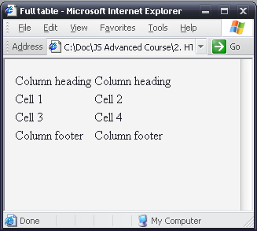
Full HTML Tables Example
Although the footer is before the data in the code, it is displayed last
table-full.html
<table>
<thead>
<tr><td>Column heading</td><td>Column
heading</td></tr>
</thead>
<tfoot>
<tr><td>Column footer</td><td>Column
footer</td></tr>
</tfoot>
<tbody>
<tr><td>Cell 1</td><td>Cell 2</td></tr>
<tr><td>Cell 3</td><td>Cell 4</td></tr>
</tbody>
</table>

Slide 13
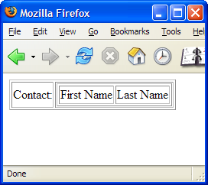
Nested Tables
Table data “cells” (<td>) can contain nested tables (tables within tables):
<table border="1">
<tr>
<td>Contact:</td>
<td>
<table border="1">
<tr>
<td>First Name</td>
<td>Last Name</td>
</tr>
</table>
</td>
</tr>
</table>
nested-tables.html
Notes:
*
07/16/96
(c) 2007 National Academy for Software Development - http://academy.devbg.org. All rights reserved. Unauthorized copying or re-distribution is strictly prohibited.*
<number>##

Slide 14
Nested Tables
Live Demo
Notes:
*
07/16/96
(c) 2007 National Academy for Software Development - http://academy.devbg.org. All rights reserved. Unauthorized copying or re-distribution is strictly prohibited.*
<number>##

Slide 15
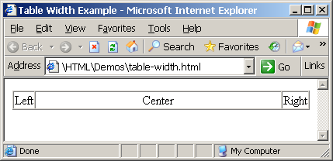
Cells Width
Tables and cells can have width attribute
  Width can be given in pixels or percentages
table-width.html
<table border="1" width="100%" cellspacing="0">
<tr>
<td>Left</td>
<td width="100%" align="center">Center</td>
<td>Right</td>
</tr>
</table>
Notes:
*
07/16/96
(c) 2007 National Academy for Software Development - http://academy.devbg.org. All rights reserved. Unauthorized copying or re-distribution is strictly prohibited.*
<number>##

Slide 16
Table Width
Live Demo
Notes:
*
07/16/96
(c) 2007 National Academy for Software Development - http://academy.devbg.org. All rights reserved. Unauthorized copying or re-distribution is strictly prohibited.*
<number>##

Slide 17
Cell Spacing and Padding
Tables have two important attributes:
cellspacing
Defines the empty space between the cells
cellpadding
Defines the empty space around the cell contents
cell
cell
cell
cell
cell
cell
cell
cell
Notes:
*
07/16/96
(c) 2007 National Academy for Software Development - http://academy.devbg.org. All rights reserved. Unauthorized copying or re-distribution is strictly prohibited.*
<number>##

Slide 18
Cell Spacing and Padding – Example
table-cells.html
<html>
<head><title>Table Cells</title></head>
<body>
<table cellspacing="15" cellpadding="0"
bgcolor="red">
<tr><td bgcolor="yellow">First</td>
<td bgcolor="yellow">Second</td></tr>
</table>
<br/>
<table cellspacing="0" cellpadding="10"
bgcolor="yellow" border="1">
<tr><td>First</td><td>Second</td></tr>
</table>
</body>
</html>
Notes:
*
07/16/96
(c) 2007 National Academy for Software Development - http://academy.devbg.org. All rights reserved. Unauthorized copying or re-distribution is strictly prohibited.*
<number>##

Slide 19
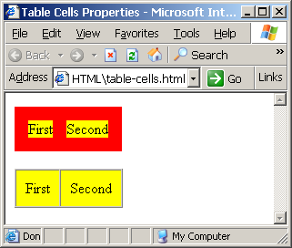
Cell Spacing and Padding – Example
table-cells.html
<html>
<head><title>Table Cells</title></head>
<body>
<table cellspacing="15" cellpadding="0"
bgcolor="red">
<tr><td bgcolor="yellow">First</td>
<td bgcolor="yellow">Second</td></tr>
</table>
<br/>
<table cellspacing="0" cellpadding="10"
bgcolor="yellow" border="1">
<tr><td>First</td><td>Second</td></tr>
</table>
</body>
</html>
Notes:
*
07/16/96
(c) 2007 National Academy for Software Development - http://academy.devbg.org. All rights reserved. Unauthorized copying or re-distribution is strictly prohibited.*
<number>##

Slide 20
Table Cell Spacing and Cell Padding
Live Demo
Notes:
*
07/16/96
(c) 2007 National Academy for Software Development - http://academy.devbg.org. All rights reserved. Unauthorized copying or re-distribution is strictly prohibited.*
<number>##

Slide 21
Column and Row Span
Table cells have two important attributes:
colspan
Defines how many columns the cell occupies
rowspan
Defines how many rows the cell occupies
colspan="1"
colspan="1"
rowspan="2"
rowspan="1"
cell[1,1]
cell[1,2]
cell[1,1]
cell[1,2]
cell[2,1]
cell[2,1]
colspan="2"
rowspan="1"
Notes:
*
07/16/96
(c) 2007 National Academy for Software Development - http://academy.devbg.org. All rights reserved. Unauthorized copying or re-distribution is strictly prohibited.*
<number>##

Slide 22
Column and Row Span – Example
table-colspan-rowspan.html
<html>
<head><title>Colspan and Rowspan</title></head>
<body>
<br/>
<table cellspacing="0" cellpadding="10"
border="1">
<tr bgcolor="yellow"><td>Cell[1,1]</td>
<td colspan="2">Cell[2,1]</td></tr>
<tr bgcolor="#FFCC66"><td>Cell[1,2]</td>
<td rowspan="2">Cell[2,2]</td>
<td>Cell[3,2]</td></tr>
<tr bgcolor="#CCCCFF"><td>Cell[1,3]</td>
<td>Cell[2,3]</td></tr>
</table>
</body>
</html>
Notes:
*
07/16/96
(c) 2007 National Academy for Software Development - http://academy.devbg.org. All rights reserved. Unauthorized copying or re-distribution is strictly prohibited.*
<number>##

Slide 23
Column and Row Span – Example
table-colspan-rowspan.html
<html>
<head><title>Colspan and Rowspan</title></head>
<body>
<br/>
<table cellspacing="0" cellpadding="10"
border="1">
<tr bgcolor="yellow"><td>Cell[1,1]</td>
<td colspan="2">Cell[2,1]</td></tr>
<tr bgcolor="#FFCC66"><td>Cell[1,2]</td>
<td rowspan="2">Cell[2,2]</td>
<td>Cell[3,2]</td></tr>
<tr bgcolor="#CCCCFF"><td>Cell[1,3]</td>
<td>Cell[2,3]</td></tr>
</table>
</body>
</html>
Cell[1,1]
Cell[2,1]
Cell[1,2]
Cell[2,2]
Cell[3,2]
Cell[1,3]
Cell[2,3]
Notes:
*
07/16/96
(c) 2007 National Academy for Software Development - http://academy.devbg.org. All rights reserved. Unauthorized copying or re-distribution is strictly prohibited.*
<number>##

Slide 24
Introduction to HTML
Creating HTML Forms
Notes:
*
07/16/96
(c) 2007 National Academy for Software Development - http://academy.devbg.org. All rights reserved. Unauthorized copying or re-distribution is strictly prohibited.*
<number>##

Slide 25
HTML Forms
Forms are the primary method for gathering data from site visitors
Create a form block with
Example:
<form></form>
The “method" attribute tells how the form data should be sent – via GET or POST request
<form name="myForm" method="post" action="path/to/some-script.php">
...
</form>
The "action" attribute tells where the form data should be sent.
It is obligatory attribute
Notes:
*
07/16/96
(c) 2007 National Academy for Software Development - http://academy.devbg.org. All rights reserved. Unauthorized copying or re-distribution is strictly prohibited.*
<number>##

Slide 26
Form Fields
Text fields are single-line entry fields:
Text areas can contain multiple lines of text:
Hidden fields contain data not shown to user:
  Often used by JavaScript code
<input type="text" name="FirstName" value="This is a text field">
<textarea name="Comments">This is a multi-line text field</textarea>
<input type="hidden" name="Account" value="This is a hidden text field">
Notes:
*
07/16/96
(c) 2007 National Academy for Software Development - http://academy.devbg.org. All rights reserved. Unauthorized copying or re-distribution is strictly prohibited.*
<number>##

Slide 27
Form Input Controls
Create a checkbox:
Create a radio button:
Radio buttons can be grouped, allowing only one to be selected from a group:
<input type="checkbox" name="fruit" value="apple">
<input type="radio" name="title" value="Mr.">
<input type="radio" name="town" value="Sofia">
<input type="radio" name="town" value="Varna">
Notes:
*
07/16/96
(c) 2007 National Academy for Software Development - http://academy.devbg.org. All rights reserved. Unauthorized copying or re-distribution is strictly prohibited.*
<number>##

Slide 28
Other Form Controls
Pull down menu (drop-down list):
Submit button:
<select name="gender">
<option value="Value 1"
selected="selected">Male</option>
<option value="Value 2">Female</option>
<option value="Value 3">Other</option>
</select>
<input type="submit" name="submitBtn" value="Apply Now">
Notes:
*
07/16/96
(c) 2007 National Academy for Software Development - http://academy.devbg.org. All rights reserved. Unauthorized copying or re-distribution is strictly prohibited.*
<number>##

Slide 29
Other Form Controls (2)
Reset button – clears the form
Image button – acts like submit but image is displayed instead of button
Ordinary button – used for JavaScript, no default action
<input type="reset" name="resetBtn" value="Clear the form">
<input type="image" src="submit.gif" name="submitBtn" alt="Submit">
<input type="button" value="simple button">

Slide 30
Other Form Controls (3)
Password input – acts like normal text field but hides the text with * signs
Multiple select field – code is like drop down but displays list of items to select
<input type="password" name="pass" value="">
<select name="products" multiple="multiple">
<option value="Value 1"
selected="selected">keyboard</option>
<option value="Value 2">mouse</option>
<option value="Value 3">speakers</option>
</select>

Slide 31
HTML Forms – Example
form.html
<form method="POST" action="apply-now.php">
<input name="subject" type="hidden" value="Class" />
<p>Degree:
<select name="degree">
<option value="BA">Bachelor of Art</option>
<option value="BS">Bachelor of Science</option>
<option value="MBA" selected="true">Master of
Business Administration</option>
</select>
</p>
<p>
First Name: <input type="text" name="firstname" />
</p>
<p>
Last Name: <input type="text" name="lastname" />
</p>
<p>
Student ID: <input type="password" name="studentid" />
</p>
Notes:
*
07/16/96
(c) 2007 National Academy for Software Development - http://academy.devbg.org. All rights reserved. Unauthorized copying or re-distribution is strictly prohibited.*
<number>##

Slide 32
HTML Forms – Example
form.html (continuation)
<p>
Gender:
<input name="gender" type="radio" value="Male"
checked="true" /> Male
<input name="gender" type="radio" value="Female" />
Female
</p>
<p>
E-mail: <input type="text" name="email" value="" />
</p>
<p>
<textarea name="terms" cols="30" rows="4"
readonly="true">TERMS AND CONDITIONS
By clicking the Send Form button you agree to submit this form.</textarea>
</p>
<p>
<input type="submit" name="button" value="Send Form" />
</p>
</form>
Notes:
*
07/16/96
(c) 2007 National Academy for Software Development - http://academy.devbg.org. All rights reserved. Unauthorized copying or re-distribution is strictly prohibited.*
<number>##

Slide 33
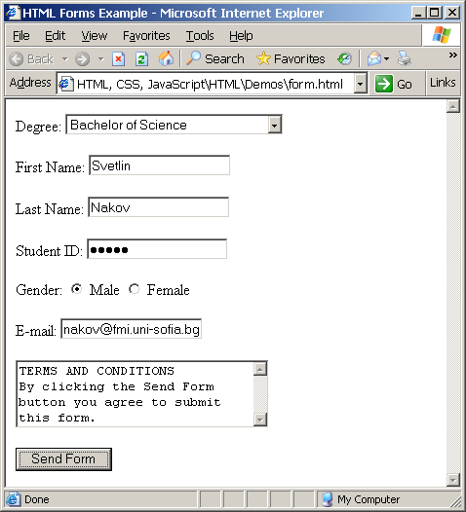
HTML Forms – Example
form.html
<p>
Gender:
<input name="gender" type="radio" value="Male"
checked="true" /> Male
<input name="gender" type="radio" value="Female" />
Female
</p>
<p>
E-mail: <input type="text" name="email" value="" />
</p>
<p>
<textarea name="terms" cols="30" rows="4"
readonly="true">TERMS AND CONDITIONS
By clicking the Send Form button you agree to submit this form.</textarea>
</p>
<p>
<input type="submit" name="button" value="Send Form" />
</p>
</form>
Notes:
*
07/16/96
(c) 2007 National Academy for Software Development - http://academy.devbg.org. All rights reserved. Unauthorized copying or re-distribution is strictly prohibited.*
<number>##

Slide 34
Questions?
Notes:
*
07/16/96
(c) 2007 National Academy for Software Development - http://academy.devbg.org. All rights reserved. Unauthorized copying or re-distribution is strictly prohibited.*
<number>##

Slide 35
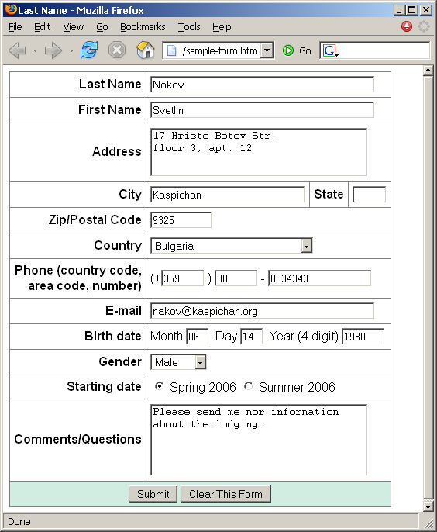
Exercises
Create a Web form that looks like this sample
See the image
Sample-form.png

Slide 36
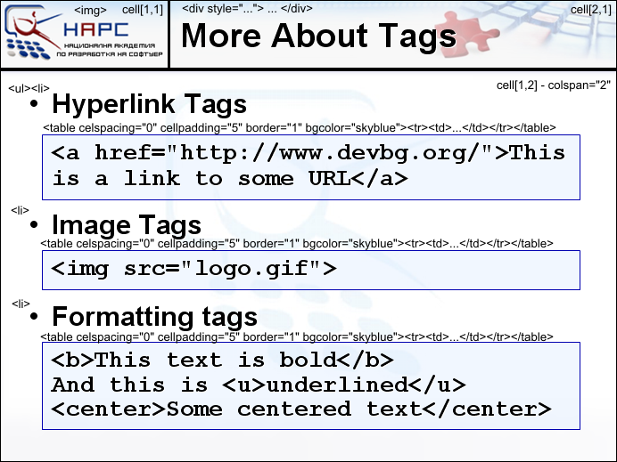
Exercises
Use the image
Sample-site.png
Create a Web page that looks like this slide:

